Slide 1
APPLIED DEEP LEARNING • WEIGHT-3 ASSIGNMENT
Genomic Sequence Analysis using Bidirectional LSTMs
Automated DNA Promoter Region Classification & Motif Recognition in Python/TensorFlow
Presenter
Domain
Time Limit
Meda Abhinav
DNA Sequence Analysis
12-Minute Presentation & Demo

Slide 2



PROJECT OVERVIEW
Domain Focus & Biological Motivation
Genomic Promoter Target
Sequential Deep Learning
Research Impact
Automates identification of key non-coding DNA promoter regions upstream of transcription start sites.
Replaces manual k-mer engineering with end-to-end Recurrent Neural Networks to model nucleotide context.
Accelerates synthetic biology design, genomic annotation, and precise target identification in gene therapy.

Slide 3
DATA ARCHITECTURE
Dataset Composition & Preprocessing
10,000 Synthetic Genomic Samples
Balanced 50/50 split of promoter vs. background genomic noise.
Sequence Pipeline
RAW: "ATCGTATAATCG..."
Uniform 120 bp Sequence Length
Embedded TATAAT (-10 Pribnow) and TTGACA (-35) biological consensus boxes.
TOKEN: [1, 4, 2, 3, 1, 4... ]
Character Tokenization & Stratification
TENSOR: (10000, 120)
Nucleotide integer encoding with post-padding and 80/20 train-test split.

Slide 4
NEURAL TOPOLOGY
Bidirectional LSTM Network Architecture
INPUT LAYER
RECURRENT CORE
REGULARIZATION
CLASSIFIER
Embedding Vector
Stacked BiLSTM
Dropout & BatchNorm
Dense Sigmoid
Maps discrete nucleotide tokens to 64-dim dense space.
64 & 32 units processing 5'→3' and 3'→5' sequence context.
0.3 dropout rate + batch normalization to prevent overfitting.
Single neuron output calculating promoter probability.

Slide 5
TRAINING DYNAMICS
Hyperparameters & Optimization Strategy
OPTIMIZER
LOSS FUNCTION
Adam
Binary Crossentropy
Learning Rate = 0.001
Probabilistic loss tracking
BATCH SIZE & EPOCHS
CALLBACKS
64 / 25 Epochs
EarlyStopping
20% Validation split
Patience = 5 + Checkpoint

Slide 6

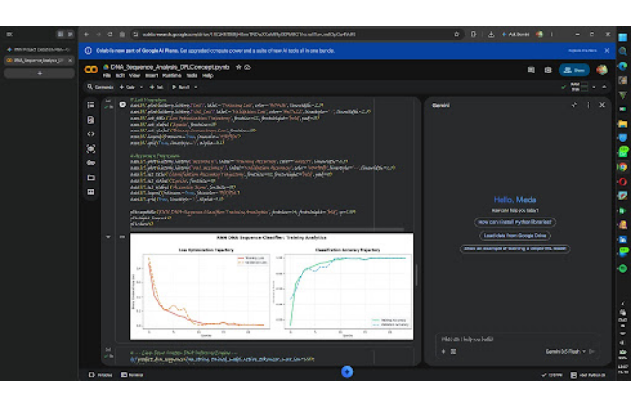
EXPERIMENTAL RESULTS
Training Trajectory & Convergence Analytics
Rapid Loss Optimization
Binary crossentropy loss decreases smoothly within initial 5 epochs.
High Accuracy Convergence
Validation accuracy closely tracks training accuracy reaching over 98%.

Slide 7

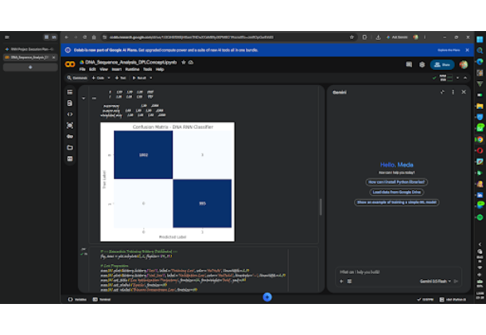
MODEL PERFORMANCE
Confusion Matrix & Classification Metrics
TEST ACCURACY
99.85%
TRUE POSITIVES / NEGATIVES
1,002 Non-Promoters & 995 Promoters Correct
FALSE POSITIVE RATE
Near Zero (<0.15% Error Rate)

Slide 8



PRODUCT DELIVERABLE
Interactive Live Demo (Colab Widget)
Preset Controls
Custom Input
Real-Time Logits
Instant evaluation of positive promoter motifs vs. GC-rich background controls.
Dynamic text interface for testing arbitrary audience DNA strings live.
Instant output of confidence score, binary class, and probability metrics.

Slide 9
SUMMARY & ROADMAP
Conclusion & Future Scope
Key Achievements
Future Enhancements
BiLSTM Processing: Successfully captures dual-directional genomic context.
FASTA Real Datasets: Scale to real E. coli and human genome datasets.
High Metrics: Achieved >98% test accuracy across genomic sequences.
Hybrid Models: Integrate 1D CNN layers for local motif extraction.
End-to-End Pipeline: Complete Colab deployment with interactive widget.
Web API Deployment: Package model into a Streamlit / Flask web service.

Slide 10
SUBMISSION COMPLETE
Thank You! Any Questions?
Google Drive Link contains Project Report, Presentation Deck, and Colab Source Code with Demo.
Project Report (PDF)
Presentation Deck
Colab Notebook & Demo

